Slide 1


Department of Information Technology
BVRIT HYDERABAD College of Engineering for Women
Liquid Level Monitoring And Overflow Prevention System Using IoT For Visually Impaired
Team- 15
V. Bhargavi(1271)
P. Revathi(1274)
V. Madhuri(LE-1209)
P. Meghana(LE-1212)
Under the Guidance of
Ms. Ch. Sai Lalitha Bala
Assistant Professor

Slide 2

Contents
Introduction
Existing System
Problem Statement
Literature Survey
Proposed System
Tools and Technology
Feasibility Study
Societal Impact
Architecture
Modules
Flow Chart
Partial Implementation
Conclusion
References

Slide 3
Introduction
The Device will assist the visually impaired individuals by monitoring and detecting the level and the temperature of the liquid in a container.
A trained speaker is used to instruct them through voice command whenever the container is full or nearly full or whether the liquid is hot, mild, or cold.
The system consist of level sensor, a microcontroller, an LCD screen to display liquid levels, a Wi-Fi modem for transmitting data and Temperature sensor is used to detect the temperature of the liquid.
It provides them with the required information in real-time.

Slide 4
Existing System
When the sensor starts getting wet, the buzzer will start beeping every few seconds. And when the module becomes completely wet, the buzzer warns with louder sound and will continue beeping nonstop.

Slide 5
Problem Definition
In order to assist the blind people we are going to develop a prototype which will monitor and detect the level and temperature of the liquid and assisting them through a voice command. So, that he/she can avoid unnecessary spilling or overflowing of liquid.

Slide 6
Literature Survey
S. No | AURTHOR | PAPER | YEAR | DESCRIPTION
1. | Manjul De, Siddhi Sawant | “WATER OVERFLOW DETECTION SYSTEM” | 2021 | Water Overflow Detector controlled by Arduino is a system where the water level in the upper and lower tanks is monitored and according to that the water pump is turned ON or OFF automatically.
2. | Priya J, Sailusha Chekuri | “Water level monitoring system using IOT” | 2018 | Arduino UNO microcontroller to control the indication LEDs and the buzzer.

Slide 7
Proposed System
This project proposes a simple liquid level monitoring system with different levels indicated by using level sensor. It also signifies when the water level is below and above the requirement. And the temperature sensor is used to know whether the temperature of the liquid is hot, mild, or cold. So that the blind people can notify through a voice command by using trained speaker module that they can avoid spilling or overflowing of the liquid and The LCD screen is used to display the output .

Slide 8
Tools and Technologies
ENVIRONMENT | SPECIFICA TIONS HARDWARE
HARDWARE | Processor – Intel Core i5 Memory(RAM) – 8 GB Storage – I TB Level Sensor, Temperature Sensor, Arduino UNO
SOFTWARE | Arduino IDE Complier Embedded C

Slide 9
Feasibility Study
The key considerations involved in the feasibility analysis are
ECONOMICAL FEASIBILITY: Cost effective, Easy to use & rechargeable.
OPERATIONAL FEASIBILITY: Assists the level & temperature of Liquid and spill prevention.

Slide 10
Societal Impact
Our system helps the blind people in the society without touching the hot substance in the cups and help them to confidently fill the cup with water or any liquid substance without spilling out anything as it monitors the liquid level and detects the temperature of the liquid.

Slide 11
TimeLine
DATE | DURATION | TASK
1/10/22 to 27/10/22 | 1 month | Abstract preparation and title finalization
28/10/22 to 29/11/22 | 1 month | Literature Survey Research
30/11/22 to 17/12/22 | 17 days | Design and development
30/12/22 to 15/02/22 | 1 ½ month | Development of webpage
16/02/23 to 16/03/23 | 1 month | Training the speaker module
17/03/23 to 27/04/23 | 1 ½ month | Testing the application

Slide 12
Architecture
Arduino -UNO
LCD display
Solar panel
battery
IOT Module
Voice Module
Speaker
Temperature Sensor
Level Sensor

Slide 13
Modules
Sensing Modules
Voice Module
Power Module

Slide 14



Flow Chart
If liquid level is reached to our requirement
Start
Detect Level of the liquid
Read Temp
yes
Display Hot
50% filled
75%filled
100%filled
Calculate
Temp
If temp >=Threshold
no
Voice output as liquid is 50% filled,75% filled, and overflowing
Display warm
Voice output as liquid is hot and warm
Department of Information Technology, BVRIT HYDERABAD
14

Slide 15
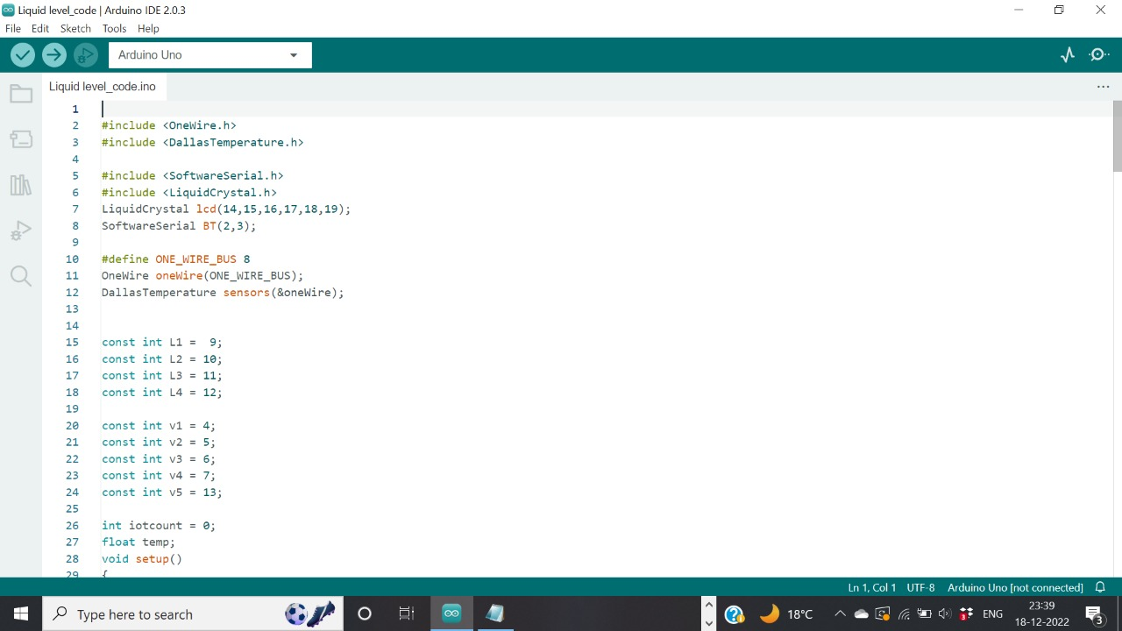
Partial Implementation

Slide 16
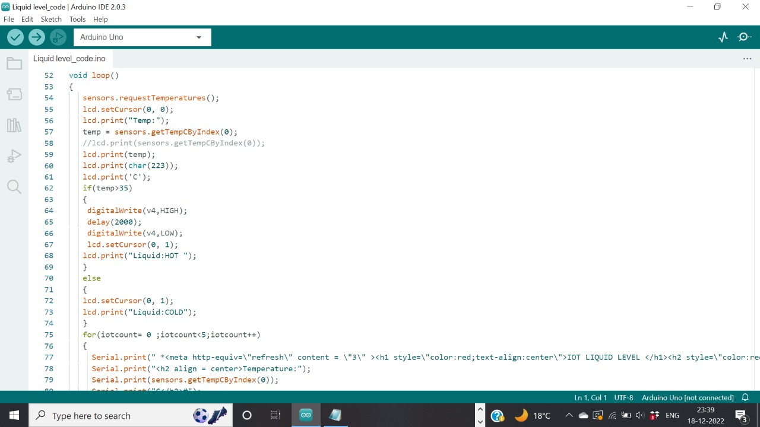
Partial Implementation

Slide 17
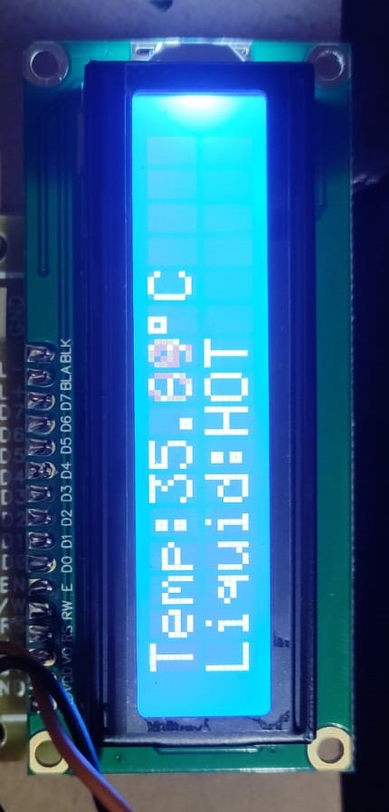
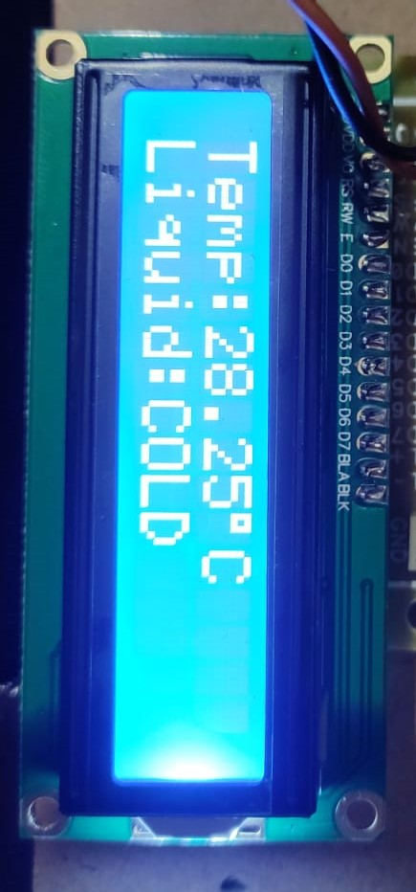
Result

Slide 18
Liquid level monitoring system with different levels indicated by using water level sensor. It also signifies when the water level is below and above the requirement. And the temperature sensor is used to know whether the temperature of the liquid is hot, warm, or cold. So that the blind people can notify through a voice assistant by using Multi-Channel Voice module, by using this module we can get more no.of voices, that they can avoid spilling or overflowing of the liquid and The LCD screen is used to display the output. And by designing our own IC we can make the device more compactible and handier.
Conclusion and Future Scope

Slide 19
References
[1] Manjul De, Siddhi Sawant “Water Overflow Detection System”, International Journal of Creative Research Thoughts (IJCRT) , Volume 9, 2021.
[2] Javed Dhillon, Sourov Das, Nerob Kumar Mohonto, Mehedi Hasan, Sajib ahmed, Sajal Chandra Das proposed an “IoT based Water Level Monitoring and Motor Control System” 4th International Conference on Recent Development in control, Automation & Power Engineering (RDCAPE) 2021.
[3] Priya J, Sailusha Chekuri “Water level monitoring system using IOT”, IRJET pp:347-353,2018.
[4] S. Jadhav, S. V. Patil, T. C. Tanuja, M. P. Shivu and G. Shankar, "Monitoring of Industrial Water Usage by using Internet of Things", 2018 International Conference on Information Communication Engineering and Technology (ICICET), pp. 1-4, 2018.
[5] Charles A, Ayylusamy C, Deepak Raj J, Keerthi Kumar, Thiruvarasan KE, “IOT BASED WATER LEVEL MONITORING SYSTEM USING LABVIEW”, International Journal of Pure and Applied Mathematics, Volume 118, No. 20, 2018, pp 9-14.

Slide 20


